Slide 1
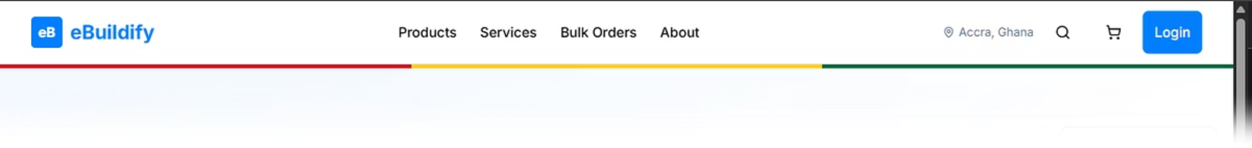
eBuildify: Construction Materials E-commerce
Presented by: BuildTech Solutions
1
Project Details
Client: Sol Little By Little Enterprises
2
Project Duration
16 weeks (June - December 2025)
3
Scope
Development of a comprehensive e-commerce platform for construction materials, including order automation, inventory management, diverse payment options, and delivery logistics optimization.
Team Members & Roles
Enoch Amarteifio: Scrum Master & Frontend Developer
Ocran Bransford Charles: Product Owner & UI/UX Designer
Abdul Rashid: Backend Developer
Jimba Muzamil: QA Engineer & Testing Lead
Timeon Able: Documentation & Demo Lead
Dompreh Jerry Jabari: Additional Developer
DevOps/CI-CD Lead: (To be assigned)

Slide 2





Problem Statement & Goals
Sol Little By Little Enterprises processes orders manually through calls and WhatsApp, causing:
01
02
Order errors and delays
Inventory discrepancies
03
04
Limited payment options
Poor delivery tracking
Project Goals
1
2
3
Automate order processing
Enable multiple payment methods
Optimize delivery logistics
with real-time inventory management
including credit facilities
with distance-based pricing
4
Target growth:
30% sales increase, 40% faster fulfillment
Key Features
Ghana Card verification system
Multi-tier user management (customers, contractors, admins)
Credit management with automated payments
Service consultation booking
Mobile-first PWA design

Slide 3
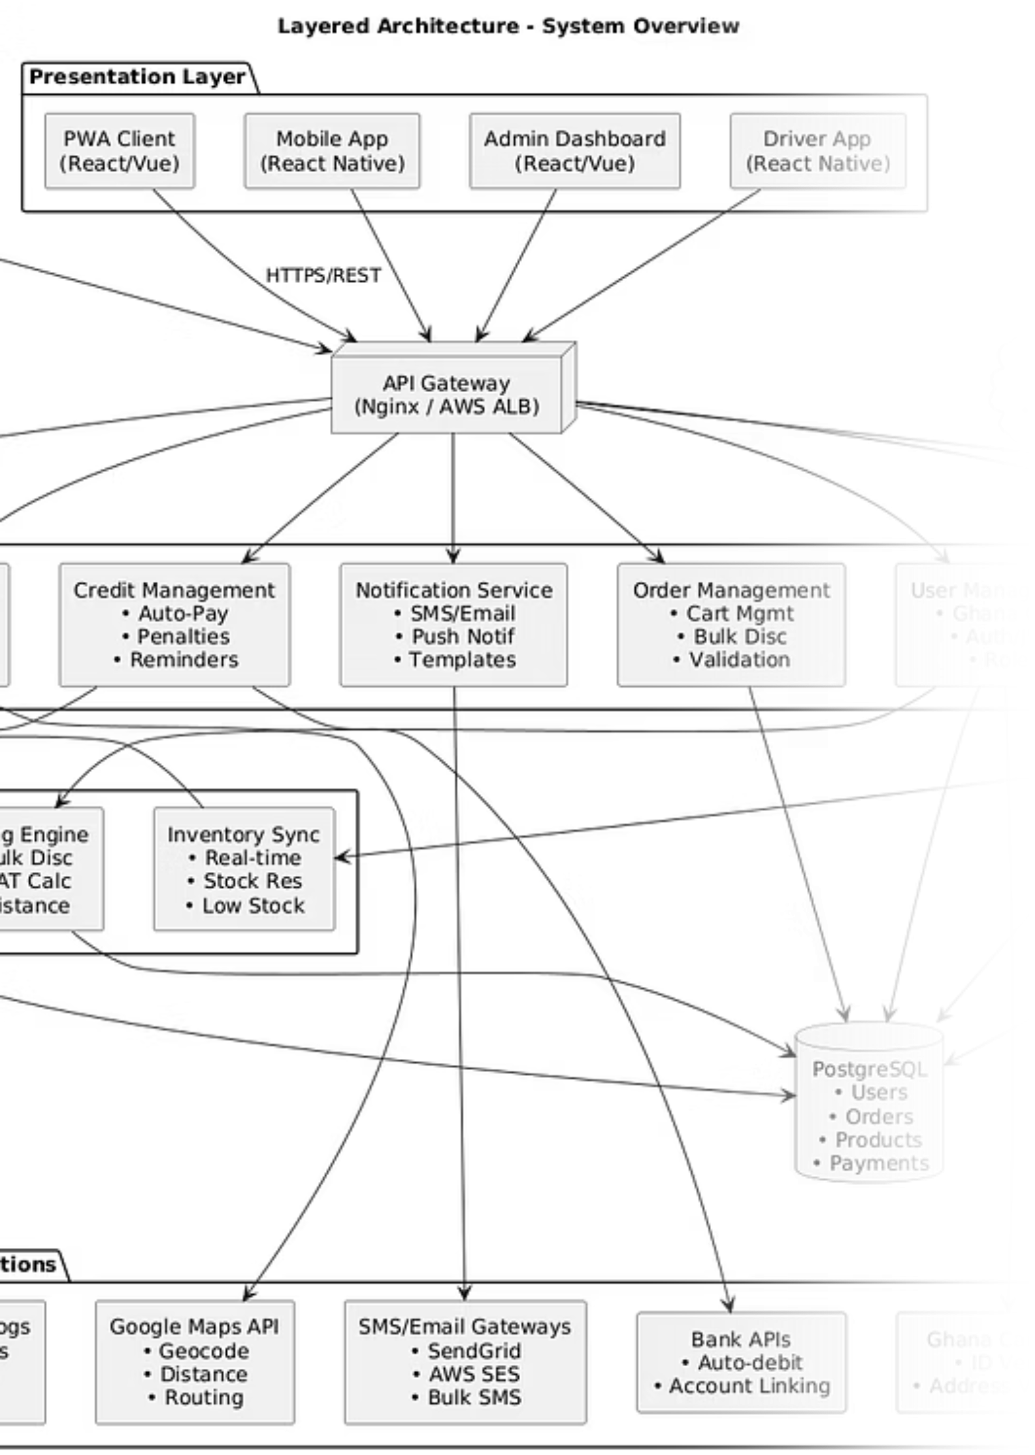




Technical Deliverables Overview
System Requirements Specification (SRS)
Product Backlog Highlights
369 story points
55 User Stories
total backlog
across 9 epics
INVEST-compliant
24 Use Cases
user stories
with complete traceability
MoSCoW prioritization
16 Non-functional requirements
framework
covering performance, security, scalability
Planning Poker estimation
with Fibonacci scale
Technical Stack
Frontend:
React 18, PWA, Tailwind CSS
Backend:
Node.js, Express, PostgreSQL
Payment:
Flutterwave (MTN MoMo, Vodafone, Telecel)
Infrastructure:
Docker, AWS/Heroku, CI/CD pipeline

Slide 4
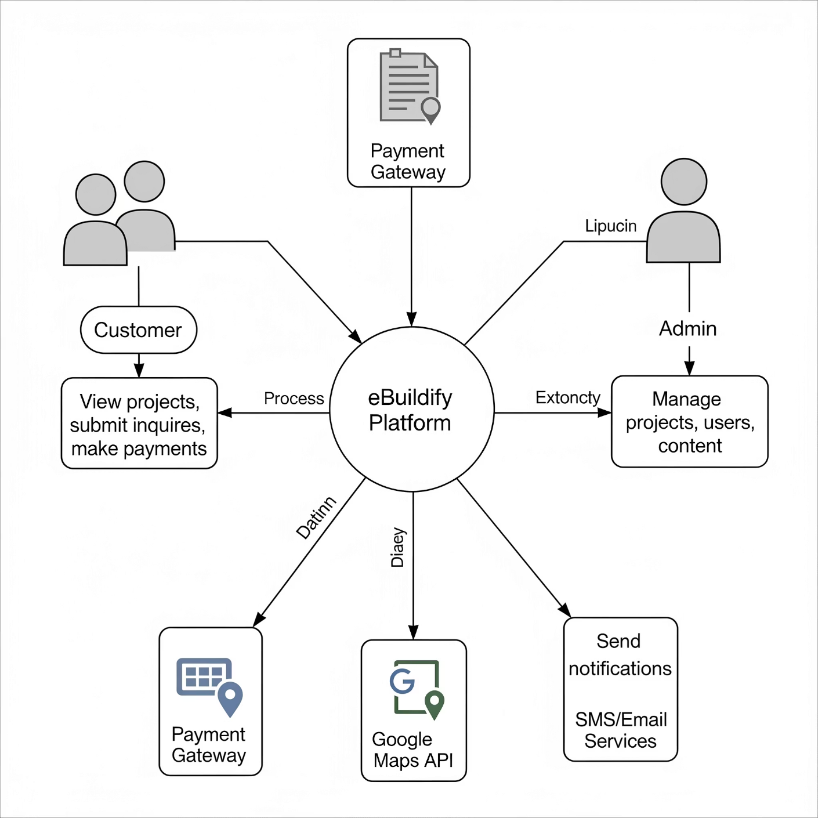




Software Engineering Models
Data Flow Diagram (Level 0)
UML Class Diagram Key Classes
User
Order
Payment
(Customer, Contractor, Admin inheritance)
→ OrderItem composition
(MTN MoMo, Credit, Card inheritance)
Credit Account
with automatic payment scheduling
System Architecture
Microservices Design:
API Gateway → Load Balancer
User Management, Product Catalog, Payment Services
PostgreSQL + Redis caching
External integrations (Flutterwave, Maps, SMS)

Slide 5

Live Demonstration
Working Prototype Features ✅
1
2
3
User Registration & Authentication
Product Catalog
Shopping Experience
Ghana Card verification system
Advanced search and filtering
Offline cart functionality
Role-based access control
Mobile-responsive design
Bulk pricing automation (1.5% discount ≥100 units)
Real-time inventory display
Product comparison tool
GitHub Repository
Organization:
Active branches:
BuildTech-Solutions
main, develop, feature branches
CI/CD Pipeline:
Code coverage:
Automated testing, deployment
92% (exceeds 80% target)

Slide 6
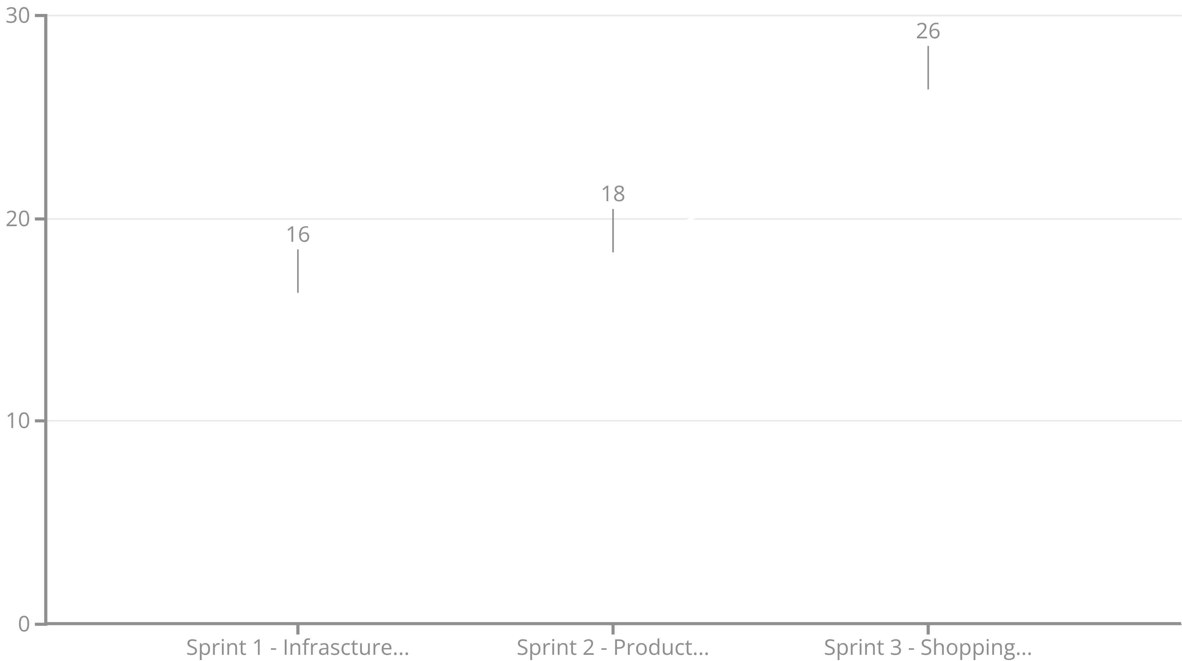
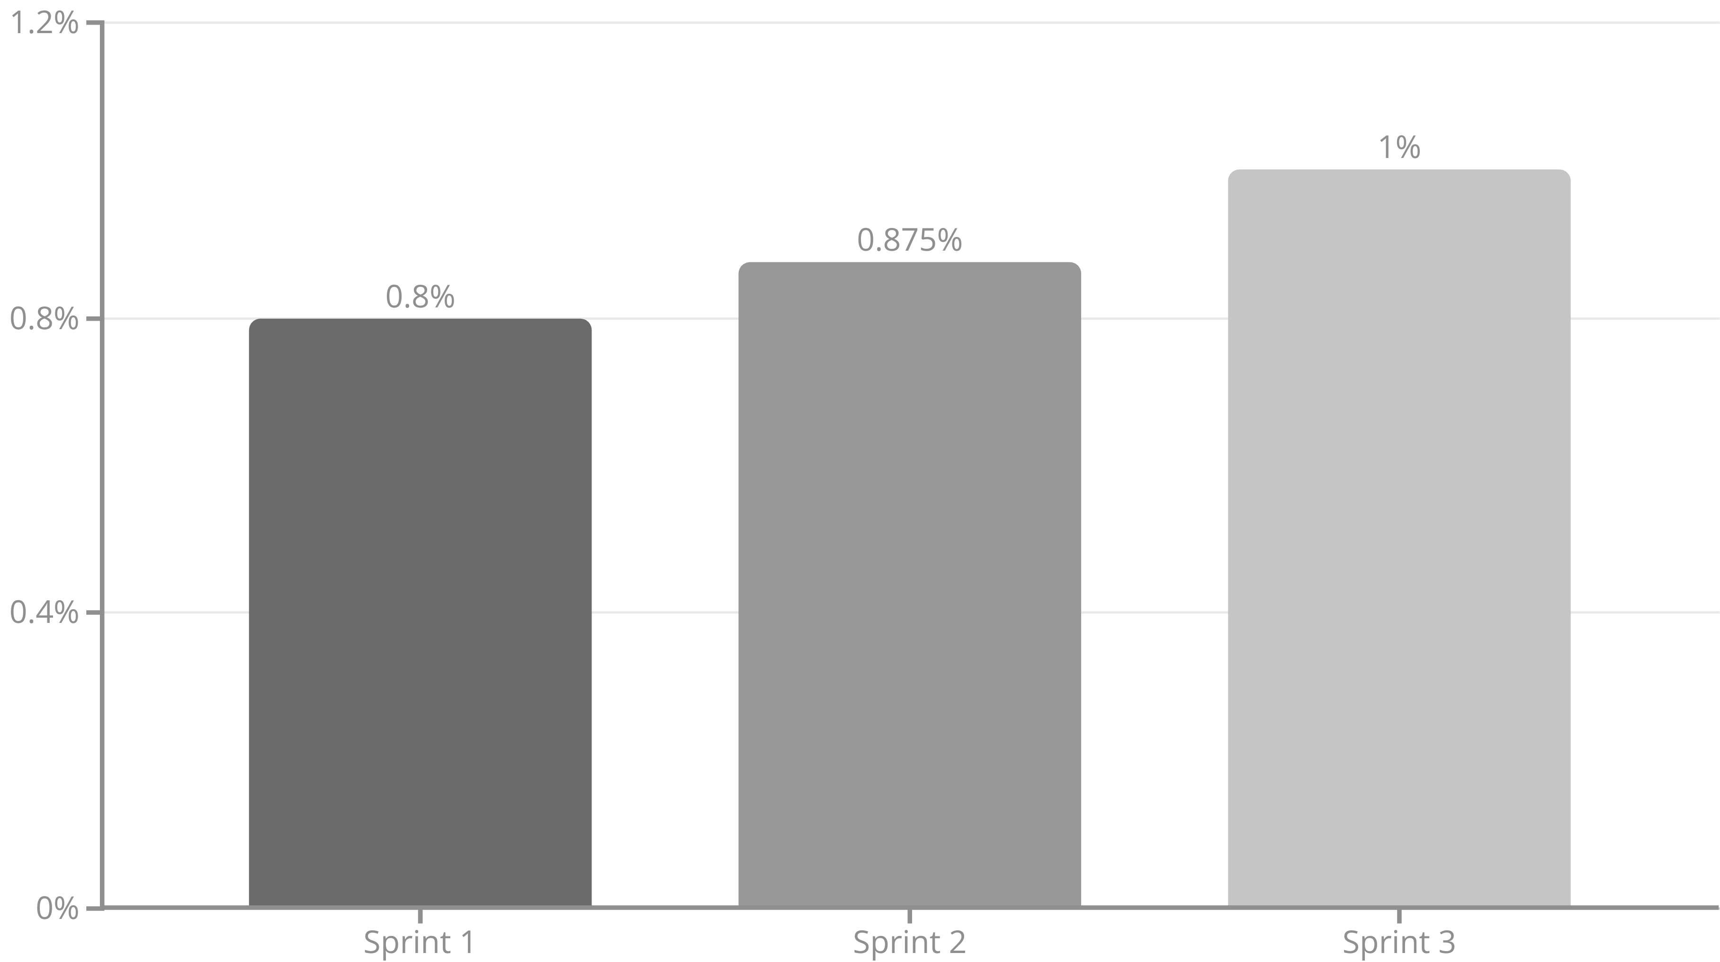
Agile Metrics Analysis
Sprint Velocity Trend
Team Velocity Growth: +62% improvement from Sprint 1 to 3
Sprint Success Rates
Key Metrics
85%
96%
0
Code Coverage
Story Point Accuracy
Quality
Consistently above
estimation accuracy in Sprint 3
critical bugs in production features

Slide 7





Sprint Reflections & Achievements
What Went Exceptionally Well ✅
Technical Foundation:
Team Maturation:
Quality Focus:
Robust CI/CD pipeline and security implementation
100% Sprint 3 completion shows growing expertise
92% code coverage with comprehensive testing
Innovation:
Client Alignment:
Offline cart functionality exceeds industry standards
All demos received positive stakeholder feedback
Key Technical Achievements
1
Ghana Card Verification:
Secure encryption and validation system
2
Payment Integration:
Flutterwave gateway ready for multiple providers
3
Offline Functionality:
Cart persists in poor connectivity areas
4
Bulk Pricing Engine:
Automated 1.5% discount system
5
Mobile Performance:
2.1 second average load time

Slide 8


Challenges & Risk Management
Major Challenges Encountered
Payment Gateway Complexity
Impact: Integration more complex than estimated
Mitigation: Dedicated payment sprint with API testing phase
Ghana Card API Integration
Challenge: Government partnership requirements unclear
Solution: Implemented basic verification with enhancement options
Team Coordination
Issue: 7-member team communication overhead
Resolution: Enhanced daily standups and clear role definitions
Risk Mitigation Strategies
Technical Spikes:
Buffer Time:
2-day research phases for complex integrations
Built into critical path activities
Fallback Options:
Multiple payment providers, offline functionality

Slide 9

Process Improvements Implemented
Agile Methodology Evolution
Sprint 1 → Sprint 3 Improvements:
Enhanced estimation accuracy (60% → 96%)
Better story decomposition following INVEST principles
Improved cross-team collaboration
Development Practices
Code Review:
CI/CD Pipeline:
Documentation:
Minimum 2 approvals before merge
Automated testing, security scans, deployment
Parallel development with features
Communication Enhancements
Client Demos:
Risk Assessment:
Knowledge Sharing:
Bi-weekly stakeholder presentations
Weekly evaluation during sprint planning
Cross-training across technical domains

Slide 10





Current Project Status
Epic Completion Overview
Epic 0: Infrastructure
100% Complete ✅
Epic 1: Order Management
95% Complete 🎯
Epic 6: Customer Verification
100% Complete ✅
Epic 2: Payment & Checkout
15% Complete 📋
Epic 3: Inventory Management
25% Complete 📋
Overall Progress
65%
Minimal
Accelerating
High
MVP Progress
Technical Debt
Team Velocity
Client Satisfaction
complete (ahead of schedule)
due to quality focus
trend
with positive demo feedback

Slide 11

Sprint 3 Objectives & Next Steps
Immediate Priorities (Next Sprint)
1
Payment Integration Sprint
Complete MTN MoMo, Vodafone Cash, Telecel Cash integration
Implement B2B credit system with admin approval workflow
Develop automatic payment scheduling and penalty system
2
Technical Goals
Maintain 90%+ code coverage
Implement PCI-DSS compliance measures
Complete payment security audit
Capacity Planning
Recommended Capacity:
Duration:
28-30 story points
7 days focused on payment complexity
Team Availability:
All 7 members ready for integration work

Slide 12



Final Release Timeline
Remaining Development Phases
Phase 4: Delivery & Logistics
Phase 5: Booking & Contractor Portal
Phase 6: Integration & Optimization
Sprints 4-5 focus on robust delivery management and logistics integration for efficient order fulfillment.
Sprints 6-7 will build out the service booking system and a dedicated portal for contractors.
Sprint 8 ensures final system integration, performance tuning, and pre-launch quality assurance.
Launch Readiness Assessment
Expected MVP Launch:
Final Launch:
Budget Status:
October 1, 2025
December 15, 2025
On track with ₵174,944 total project cost
Success Metrics Target
Performance:
Capacity:
Business Impact:
<3 seconds load time on 3G networks
Support 500+ concurrent users
30% sales increase, 40% faster fulfillment

Slide 13





Thank You!
Questions?
Primary Contact
Email
Phone
Enoch Amarteifio (Scrum Master)
amarteifioenoch4@gmail.com
0542972982
Repository
Team YouTube
github.com/enoch-amart/BuildTech-Solutions
@buildtechsolutions
We are ready for your live demo and technical questions!

